Slide 1

Wel come

Slide 2
Introducing
Md:Anwar Hossain
Lecturer of English
Class-eleven
Konabakhail Fazil
Madrasha ,Trishal
mymensingh
Sub :English
Time-4o

Slide 3
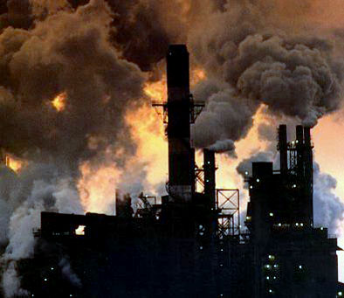

Slide 4
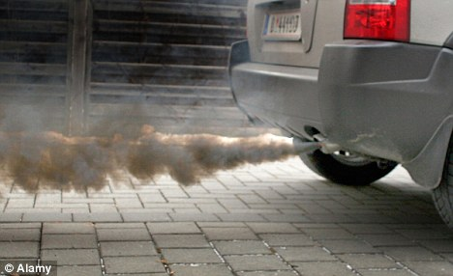

Slide 5
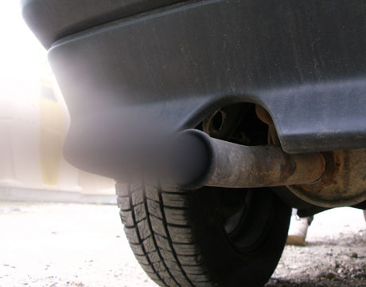

Slide 6
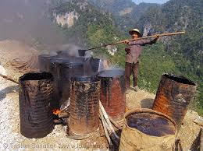
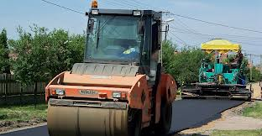

Slide 7
Air Pollution

Slide 8
Learning outcome
Can learn about air pollution
Will be able to know the reason of air pollution
Will be able to save our air from pollution

Slide 9
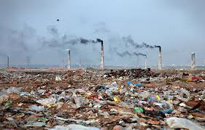
New word
Smoke from industrial toxic

Slide 10
Smoke from vehicle

Slide 11
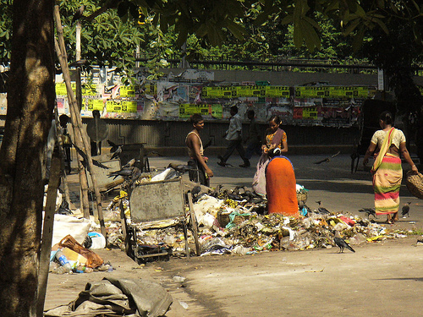
Waste materials

Slide 12
Smoke from melting pitch

Slide 13
Group work
Padma ask new words to Meghna
Meghna will give answer and ask new word to Padma

Slide 14
Home work
1.Will learn the new words
2.Will write three reasons for air pollution
3.Will read the passage very carefully

Slide 15

Thanks

